Slide 1
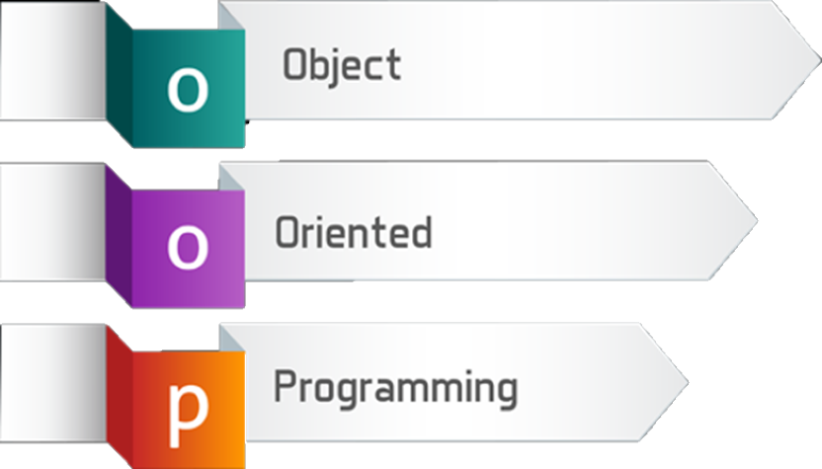
Defining Classes
Classes, Fields, Constructors, Properties, Methods
SoftUni Team
Technical Trainers
Software University
http://softuni.bg

Slide 2
Table of Contents
Abstract Data Types
Defining Simple Classes
Fields
Properties
Methods
Constructors

Slide 3
Have a Question?
sli.do
#fund-csharp

Slide 4

Abstract Data Type
Hide Details from the Client

Slide 5
Abstract Data Type
Data type whose representation is hidden from the client
string ADT – indexed sequence of chars:
string()
int Length()
char CharAt(int index)
boolean IsEmpty()
// many others…
ADTs are defined by their usage

Slide 6


Abstract Data Type (2)
You don't need to know the implementation to use an ADT
Dog:
Dog()
string Name()
void Bark()
void Sleep()
Computer:
Computer()
void TurnOn()
void TurnOff()
string Spec()

Slide 7

Defining Classes
Creating Class for an ADT

Slide 8
Defining Simple Classes
Class is a concrete implementation of an ADT
Classes provide structure for describing and creating objects
Keyword
Class name
class Dice
{
…
}
Class body

Slide 9


Naming Classes
Name classes with nouns using PascalCasing
Use descriptive nouns
Avoid abbreviations (except widely known, e.g. URL, HTTP, etc.)
class Dice { … }
class BankAccount { … }
class TPMF { … }
class bankaccount { … }
class intcalc { … }

Slide 10
Class Members
Class is made up of state and behavior
Fields store state
Methods describe behaviour
class Dice
{
int sides;
string type;
void Roll(){ … }
}
class Dog
{
int age;
string type;
void Bark(){ … }
}
Fields
Fields
Method
Method

Slide 11

Creating an Object
A class can have many instances (objects)
class Program
{
public static void Main()
{
Dice diceD6 = new Dice();
Dice diceD8 = new Dice();
}
}
Use the new keyword
Variable stores a reference

Slide 12
Object Reference
Declaring a variable creates a reference in the stack
The new keyword allocates memory on the heap
Dice diceD6 = new Dice();
STACK
HEAP
obj
diceD6
(1540e19d)
type = null
sides = 0

Slide 13
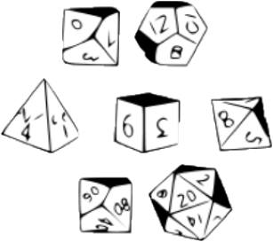

Classes vs. Objects
Classes provide structure for describing and creating objects
An object is a single instance of a class
Dice is…
Dice ADT
Dice (Class)
D6 Dice (Object)

Slide 14
Classes vs. Objects
Classes provide structure for creating objects
An object is a single instance of a class
class
Dice
Object name
Class name
object diceD6
type: string
sides: int
Class data
type = "six sided"
sides = 6
Roll(…)
Class actions
Object data

Slide 15

Class Data
Storing Data Inside a Class

Slide 16
Fields and Modifiers
Class fields have type and name
Classes and class members have modifiers that define visibility
public class Dice
{
private string type;
private int sides;
private int[] rollFrequency;
private Person owner;
public void Roll () { … }
}
Class modifier
Fields should always be private
Fields can be of any type

Slide 17
Properties
Used to create accessors and mutators (getters and setters)
public class Dice
{
private int sides;
public int Sides
{
public get { return this.sides; }
public set { this.sides = value; }
}
}
The field is hidden
The getter provides access to the field
The setter provides field change

Slide 18
Problem: Bank Account
Create a class BankAccount
private int id;
private decimal balance;
public int Id
{
get { return this.id; }
set { this.id = value; }
}
//TODO: Create Balance Getter & Setter
BankAccount
-id:int
-balance:decimal
(no actions)

Slide 19

Methods
Defining a Class Behaviour

Slide 20
Methods
Store executable code (algorithm) that manipulate state
public class Dice
{
private int sides;
private Random rnd = new Random();
public int Roll() {
int rollResult = rnd.Next(1, this.sides + 1);
return rollResult;
}
}
this points to the current instance

Slide 21

Problem: Bank Account Methods
Create a class BankAccount
BankAccount
-id:int
-balance:decimal
+Id:int
+Balance:decimal
+Deposit(decimal amount):void
+Withdraw(decimal amount):void
+ToString():string

Slide 22
Solution: Bank Account Methods
private decimal balance;
public void Deposit(decimal amount) {
this.Balance += amount;
}
public void Withdraw(decimal amount) {
this.Balance -= amount;
}
public override string ToString() {
return $"Account {this.Id}, balance {this.Balance}";
}
Check your solution here: https://judge.softuni.bg/Contests/674/Defining-Classes-Lab

Slide 23
Problem: Test Client
Create a test client that tests your BankAccount class
Support commands:
Create {Id}
Deposit {Id} {Amount}
Withdraw {Id} {Amount}
Print {Id}
End
Create 1
Create 1
Deposit 1 20
Withdraw 1 30
Withdraw 1 10
Print 1
End
Account already exists
Insufficient balance
Account ID1, balance 10.00
Check your solution here: https://judge.softuni.bg/Contests/674/Defining-Classes-Lab

Slide 24
Solution: Test Client
var accounts = new Dictionary<int, BankAccount>();
string command;
while ((command = Console.ReadLine()) != "End") {
var cmdArgs = command.Split();
var cmdType = cmdArgs[0];
switch (cmdType) {
case "Create": Create(cmdArgs, accounts); break;
case "Deposit": Deposit(cmdArgs, accounts); break;
case "Withdraw": Withdraw(cmdArgs, accounts); break;
case "Print": Print(cmdArgs, accounts); break;
}
}
Check your solution here: https://judge.softuni.bg/Contests/674/Defining-Classes-Lab

Slide 25
Solution: Test Client (2)
//Account creation
var id = int.Parse(cmdArgs[1]);
if (accounts.ContainsKey(id))
{ Console.WriteLine("Account already exists"); }
else {
var acc = new BankAccount();
acc.Id = id;
accounts.Add(id, acc);
}
// TODO: Implement other commands…
Check your solution here: https://judge.softuni.bg/Contests/674/Defining-Classes-Lab

Slide 26

Constructors
Object Initialization

Slide 27
Constructors
Special methods, executed during object creation
The only one way to call a constructor in C# is through the keyword new
public class Dice
{
private int sides;
public Dice() {
this.sides = 6;
}
}
Overloading default constructor

Slide 28
Object Initial State
Constructors set object's initial state
public class Dice
{
int sides;
int[] rollFrequency;
public Dice(int sides) {
this.sides = sides;
this.rollFrequency = new int[sides];
}
}
Always ensure correct state

Slide 29
Multiple Constructors
You can have multiple constructors in the same class
public class Dice
{
private int sides;
public Dice() { }
public Dice(int sides)
{
this.sides = sides;
}
}
Constructor without parameters
Constructor with parameters

Slide 30
Constructor Chaining
Constructors can call each other
public class Person {
private string name;
private int age;
public Person() {
this.age = 18;
}
public Person(string name) : this() {
this.name = name;
}
}
Calls default constructor

Slide 31

Problem: Define Person Class
Define a class Person
Person
-name:string
-age:int
-accounts:List<BankAccount>
+GetBalance():decimal
+Person(String name, int age)
+Person(String name, int age, List<BankAccount> accounts)

Slide 32
Solution: Define Person Class
public class Person
{
private string name;
private int age;
private List<BankAccount> accounts;
public Person() {
this.accounts = new List<BankAccount>();
}
//continues on the next slide
Ensuring correct state
Check your solution here: https://judge.softuni.bg/Contests/674/Defining-Classes-Lab

Slide 33
Solution: Define Person Class (2)
public Person(string name, int age) : this() {
this.age = age;
this.name = name;
}
public Person(string name, int age, List<BankAccount> accounts)
: this(name, age) {
this.accounts.AddRange(accounts);
}
Calling the empty constructor
Check your solution here: https://judge.softuni.bg/Contests/674/Defining-Classes-Lab

Slide 34

Summary
…
…
…
Classes define structure for objects
Objects are instances of a class
Classes define fields, methods, constructors and other members
Constructors:
Invoked when creating new instances
Initialize the object's state

Slide 35
https://softuni.bg/courses/csharp-oop-basics

Slide 36













SoftUni Diamond Partners

Slide 37





SoftUni Organizational Partners

Slide 38




Trainings @ Software University (SoftUni)
Software University – High-Quality Education and Employment Opportunities
softuni.bg
Software University Foundation
http://softuni.foundation/
Software University @ Facebook
facebook.com/SoftwareUniversity
Software University Forums
forum.softuni.bg

Slide 39

License
This course (slides, examples, demos, videos, homework, etc.) is licensed under the "Creative Commons Attribution-NonCommercial-ShareAlike 4.0 International" license

